Slide 1
Nexus Omni Accessories Kits
September 2025

Slide 2
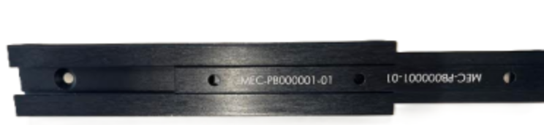
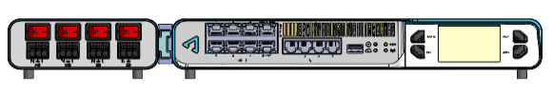
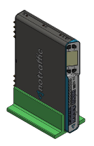
Shelf Mounting Kit - KIT-AC000013-00
Kit includes: 1X 1X
Supported mounting options:
Side By Side Nexus Omni + Sensor Power Unit mounting adapter
Nexus Omni vertical stand for shelf mount

Slide 3


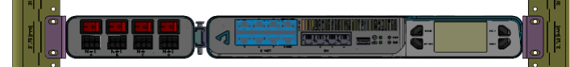
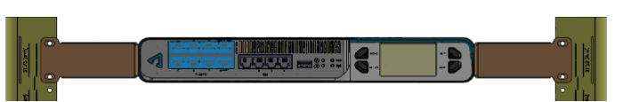
19” Rack Mounting Kit - KIT-AC000012-00
Kit includes: 1X 2X 2X
Supported mounting options:
Side by Side Mounting brackets
Nexus Omni Stand alone mounting brackets
Sensor Power Unit Stand alone mounting brackets

Slide 4
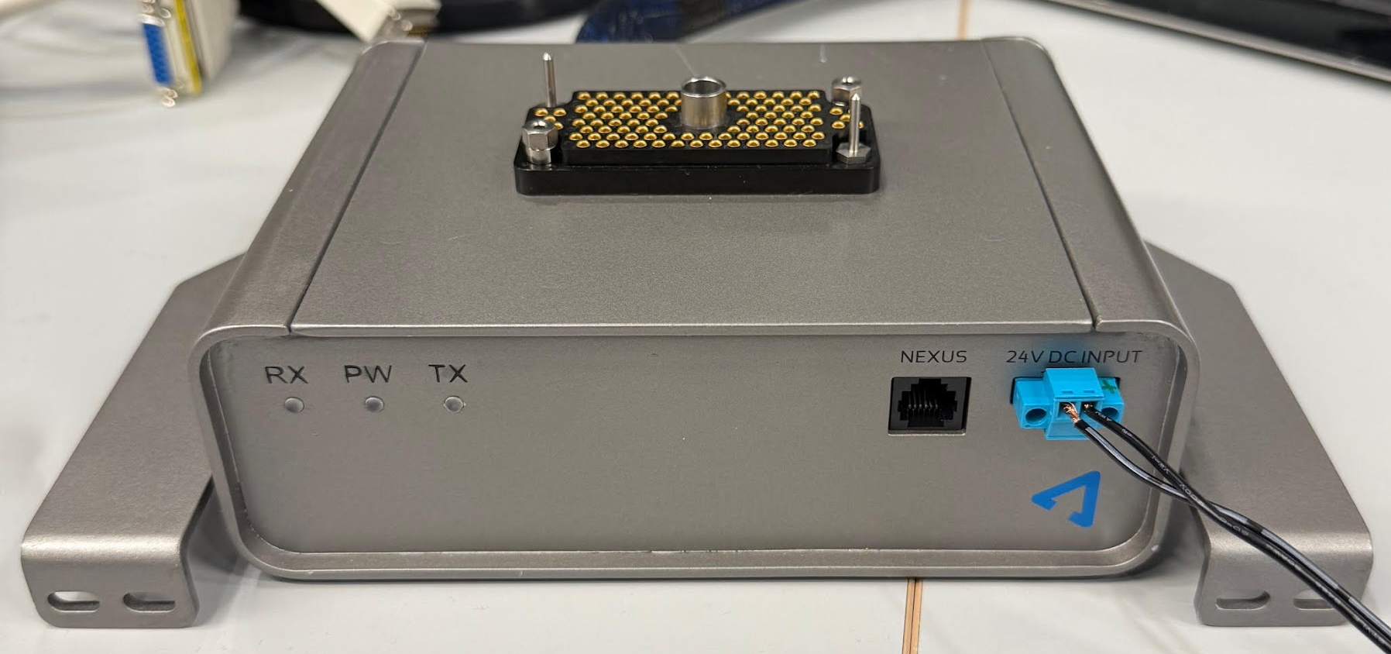
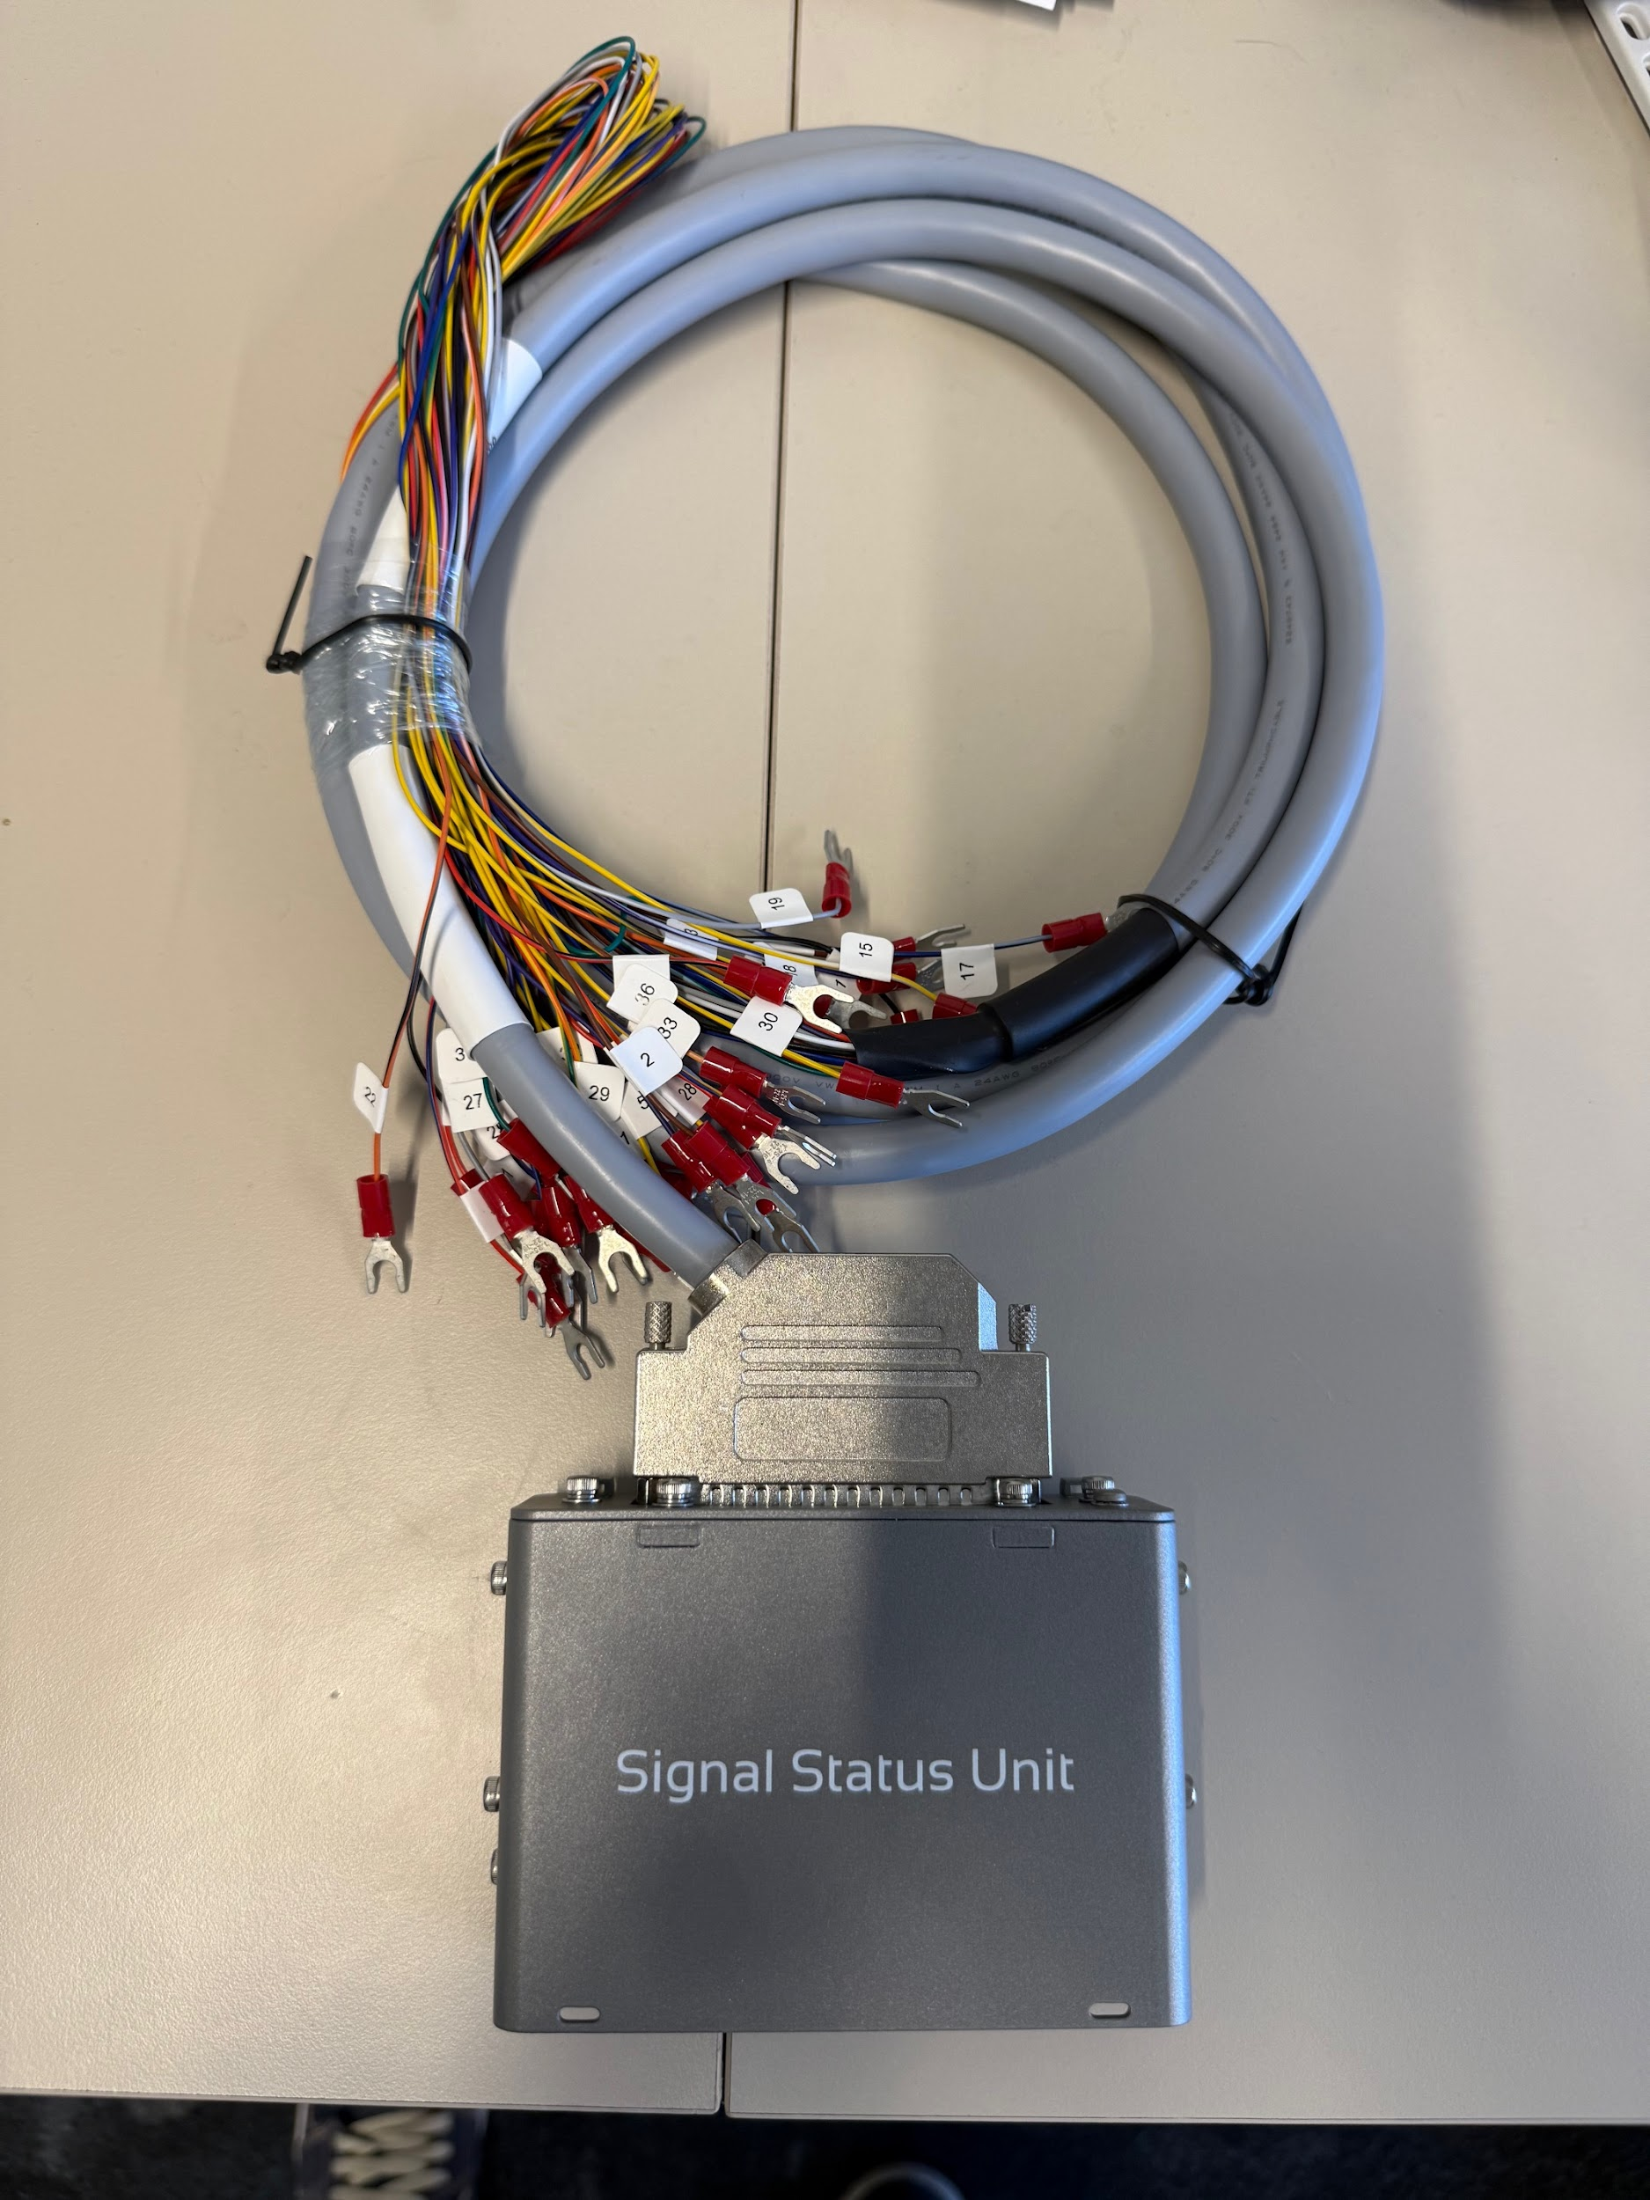
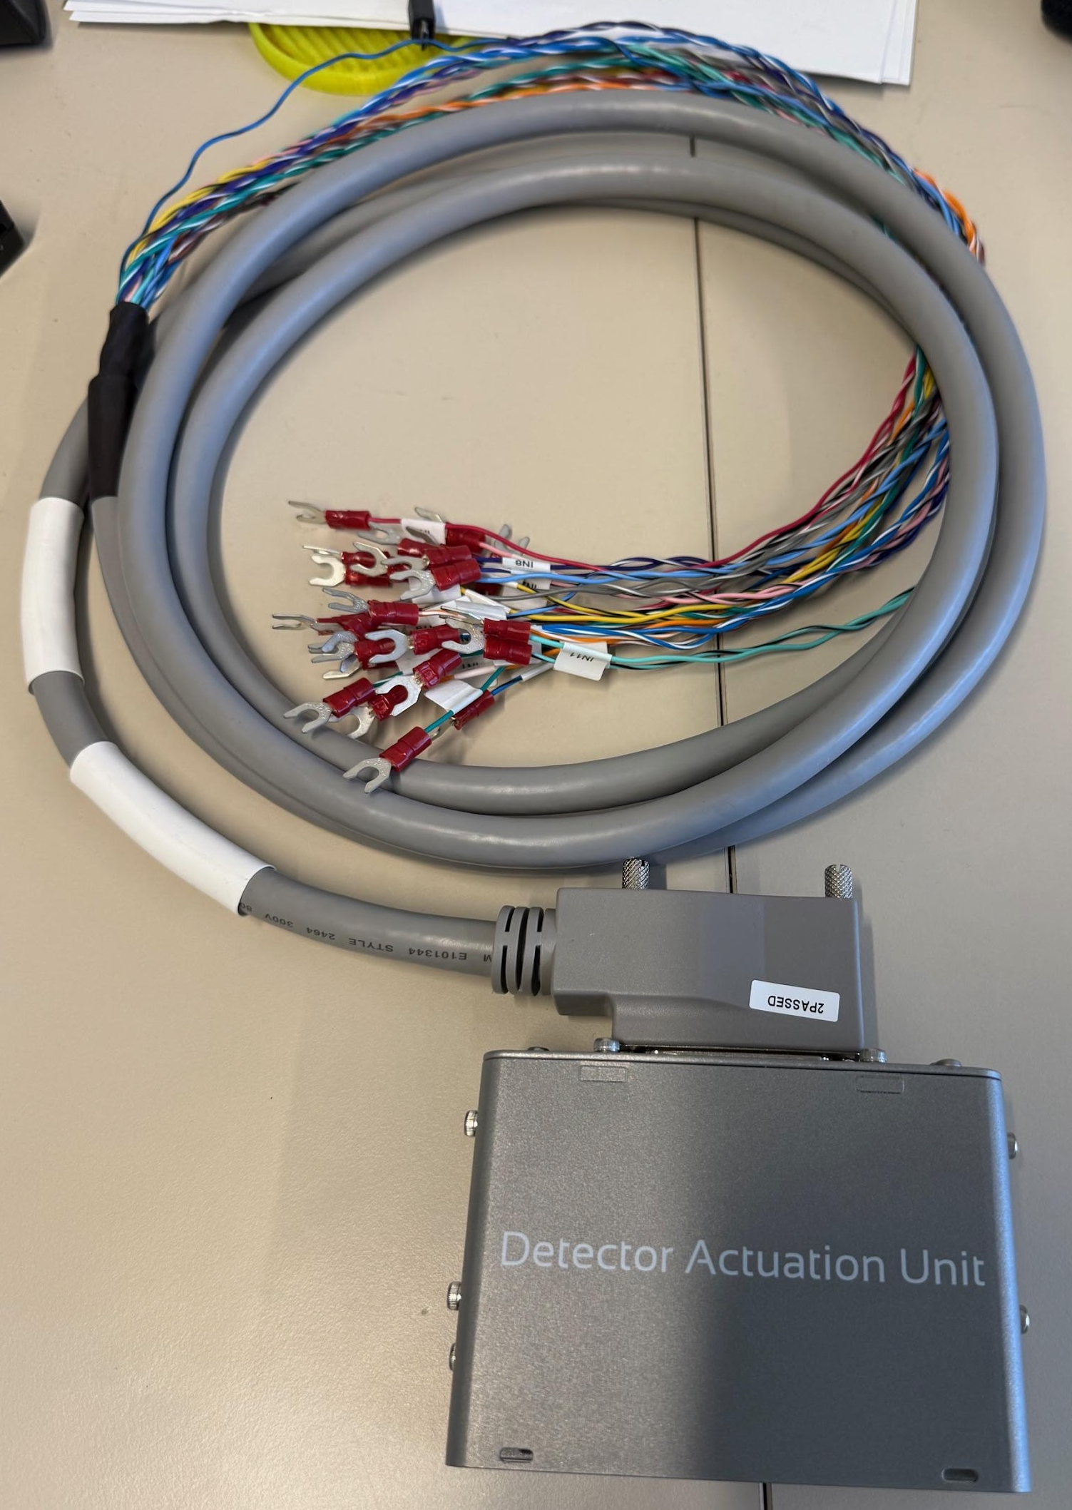
Smart Harness
C1 Smart Harness - KIT-AC000014-00
Signal Status Unit Smart Harness (ABC – TLS) - KIT-AC000016-00
Detector Actuation Unit Smart Harness (ABC – Detection) - KIT-AC000017-00

Slide 5
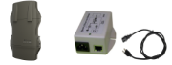
Repeater Kits
Wireless Repeater Kit - KIT-AC000007-00 (Wi-Fi repeater) goes with KIT-AC000015-00 (Active PoE injector)
Wired repeater kit – Not released yet, Solution is under evaluation
Mixed repeater kit - A remote Wi-Fi repeater is installed (over 100m run of CAT5), will require a wired repeater, This will need KIT-AC000007-00 and KIT-AC000015-00, and at least one KIT-AC000006-00 (but no KIT-AC000008-01).

Slide 6
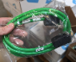
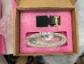
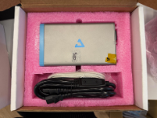
Accessories – cables and spare parts
15 to 25 pins SDLC cable – BIU - CBL-AC000014-00
15 to 25 pins SDLC cable – SIU - CBL-AC000015-00
Spare Part – SDLC Smart Harness - PRD-SD000002-00
Sensor Power Unit - PRD-PB000001-00

